Slide 1
Giant Sounding Plate
7
Ondřej Sedláček
For team GCHD

Slide 2
Task definition
When a large, thin and flexible plate (e.g. plastic, metal or plexiglass) is bent, it may produce a loud and unusual howling sound. Explain and investigate this phenomenon.

Slide 3
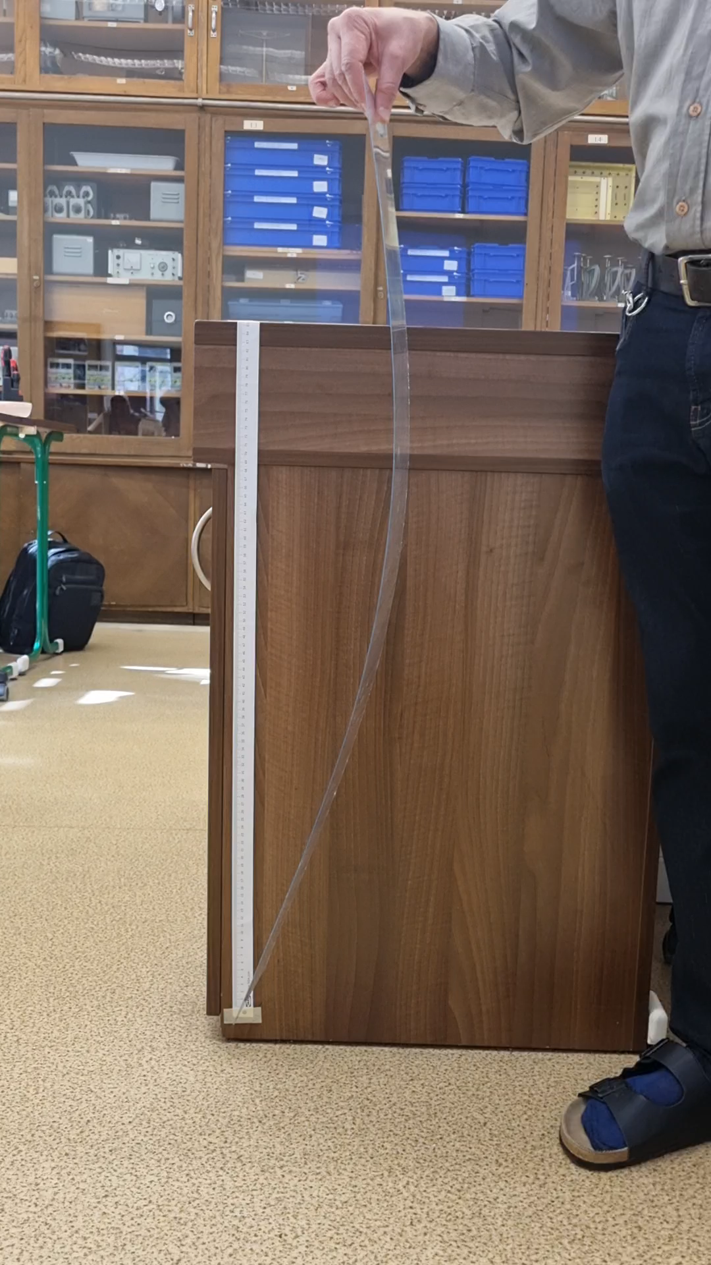
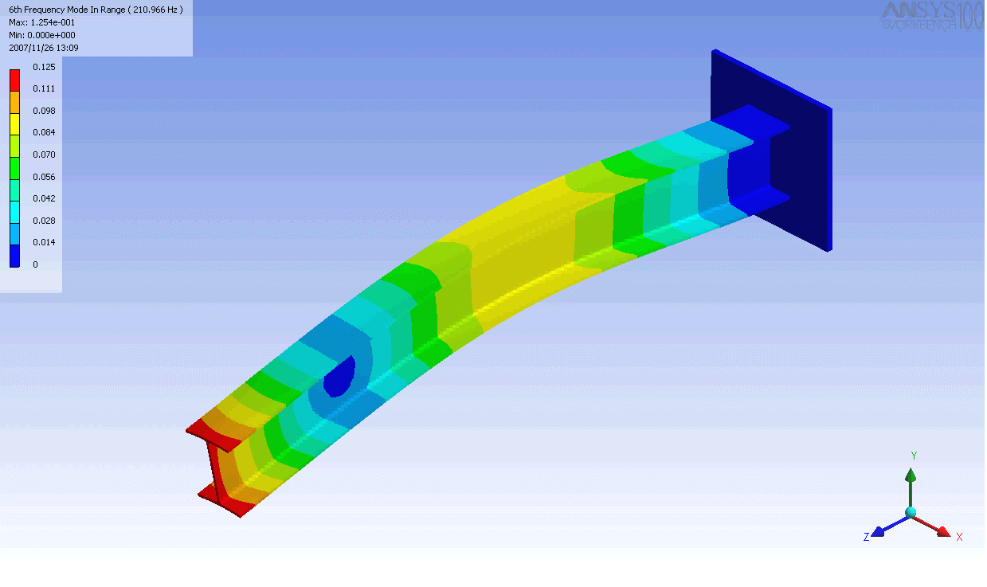

Observations
Introduction
The flexural (bending) motion of the plate does not follow simple harmonic motion (the free end is neither a node or an anti-node [1])
Euler–Bernoulli beam theory
Cantilever beam (fixed-free)
The pitch of the howling sound changes in time
The howling only occurs when bending in the other direction occurs and the plate „snaps“ [2] (bistable-system, bimetallic snap thermostat)
Howling sound example:
[1] https://en.wikipedia.org/wiki/Euler%E2%80%93Bernoulli_beam_theory [2] https://www.youtube.com/watch?v=x5Auq36vTGQ

Slide 4
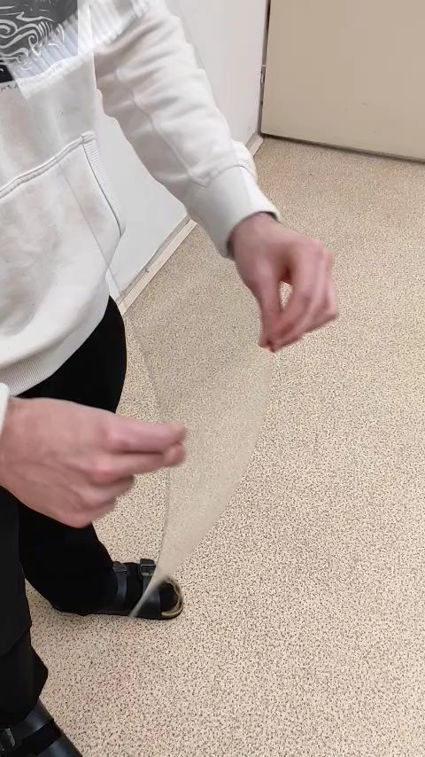
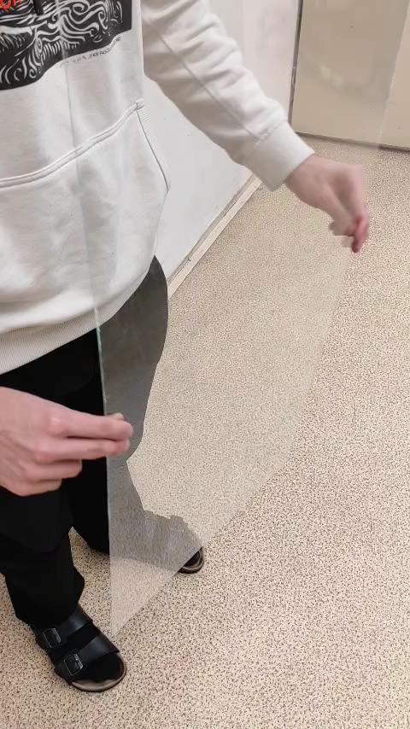
Observations
Introduction
No howling on a narrow strip:
Howling on a wider strip when passing through
the point of 0 curvature:
A sharp „snap“

Slide 5
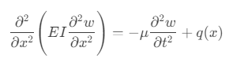
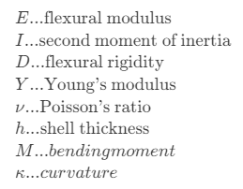
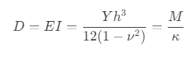
Euler–Bernoulli beam theory
Theory
The governing Euler-Lagrange equations describe the relation of 1D beam deflection and applied load:
Flexular rigidity [3][4] (material constant):
Solutions are often non-trivial and
highly dependent on boundary conditions
[3] https://en.wikipedia.org/wiki/Bending_stiffness
[4] https://en.wikipedia.org/wiki/Flexural_rigidity

Slide 6
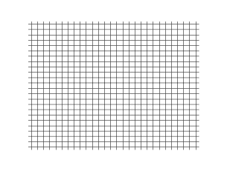
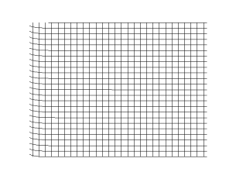
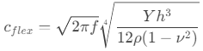
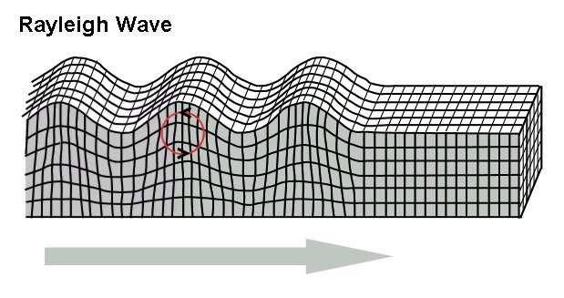
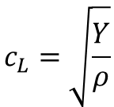
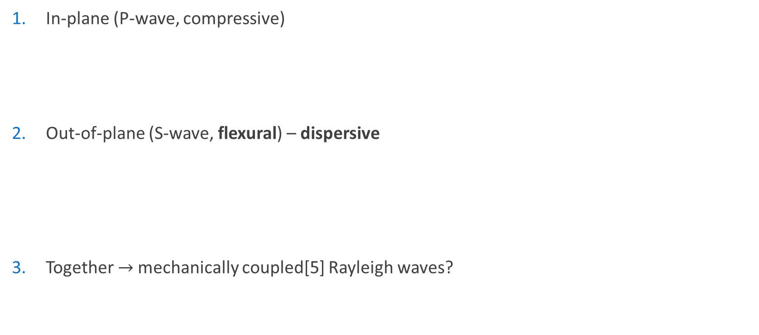
Occurring waves
Theory
In-plane (P-wave, compressive)
Out-of-plane (S-wave, flexural) – dispersive
Together $→$mechanically coupled[5] Rayleigh waves?
$$c_{L}=\sqrt{\frac{Y}{ρ}}$$
[5] https://doi.org/10.1073/pnas.2117241119

Slide 7
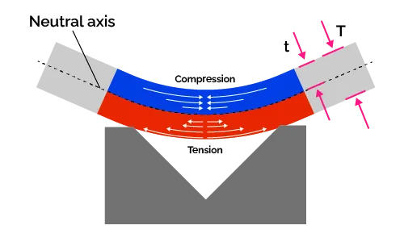
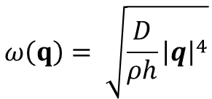
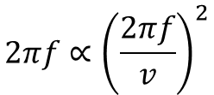
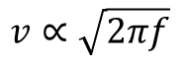
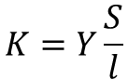
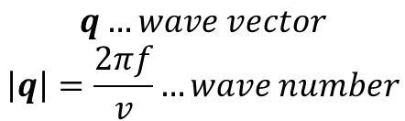
Causes for pitch change
Theory
The change of bending stiffness due to uneven stresses on the plate while bent:
The dispersive nature [5][7] of the wavespeed
$$K=Y\frac{S}{l}$$
$$ω\left(q\right)= \sqrt{\frac{D}{ρh}{\left|q\right|}^{4}}$$
$$q…wave vector$$
$$\left|q\right|=\frac{2πf}{v}…wave number$$
$$2πf∝{\left(\frac{2πf}{v}\right)}^{2}$$
$$v∝\sqrt{2πf}$$
[5] https://doi.org/10.1073/pnas.2117241119
[6] http://ilyam.org/georgia2001/02_Singing_saw_Nona_Karalashvili_Maxim_Matosov_9-14_Georgia_IYPT_2001.pdf
[7] https://www.acs.psu.edu/drussell/Demos/Dispersion/Flexural.html

Slide 8

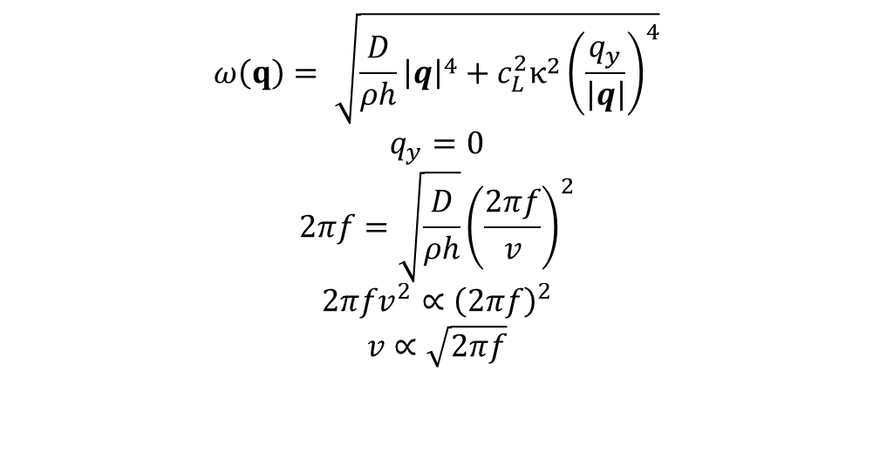
$$ω\left(q\right)= \sqrt{\frac{D}{ρh}{\left|q\right|}^{4}+c_{L}^{2}κ^{2}{\left(\frac{q_{y}}{\left|q\right|}\right)}^{4}}$$
$$q_{y}=0$$
$$2πf=\sqrt{\frac{D}{ρh}}{\left(\frac{2πf}{v}\right)}^{2}$$
$$2πfv^{2}∝{\left(2πf\right)}^{2}$$
$$v∝\sqrt{2πf}$$
$$q…wave vector$$
$$\left|q\right|=\frac{2πf}{v}…wave number$$

Slide 9
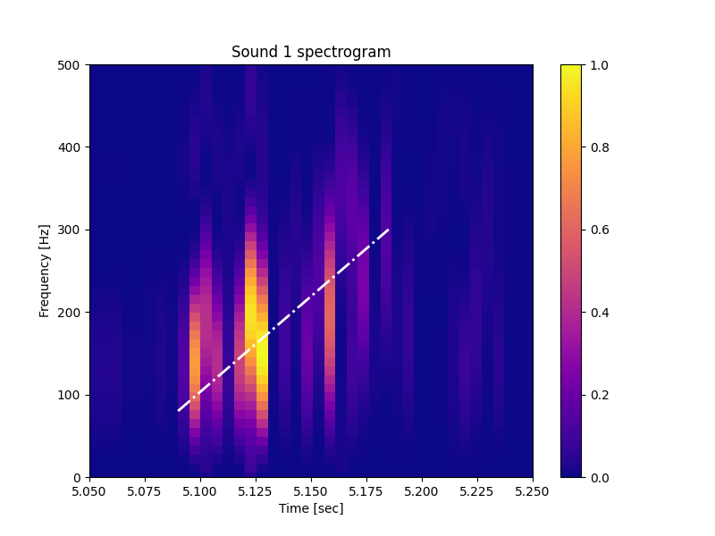
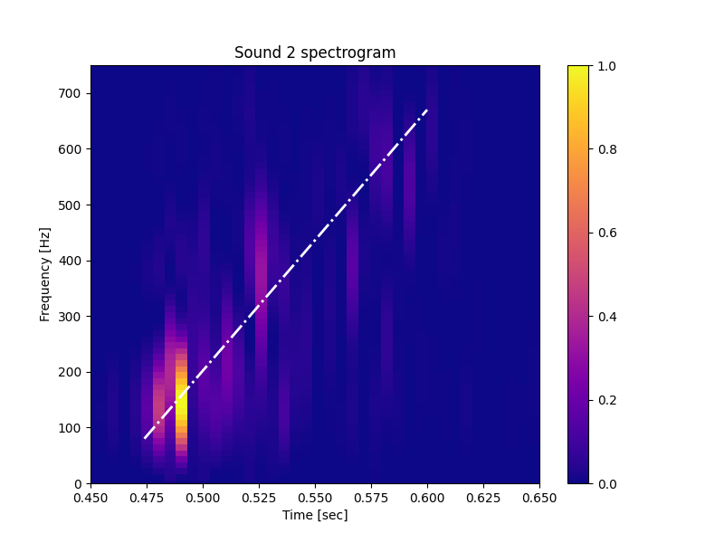
Measurement of the pitch change
Measurement

Slide 10
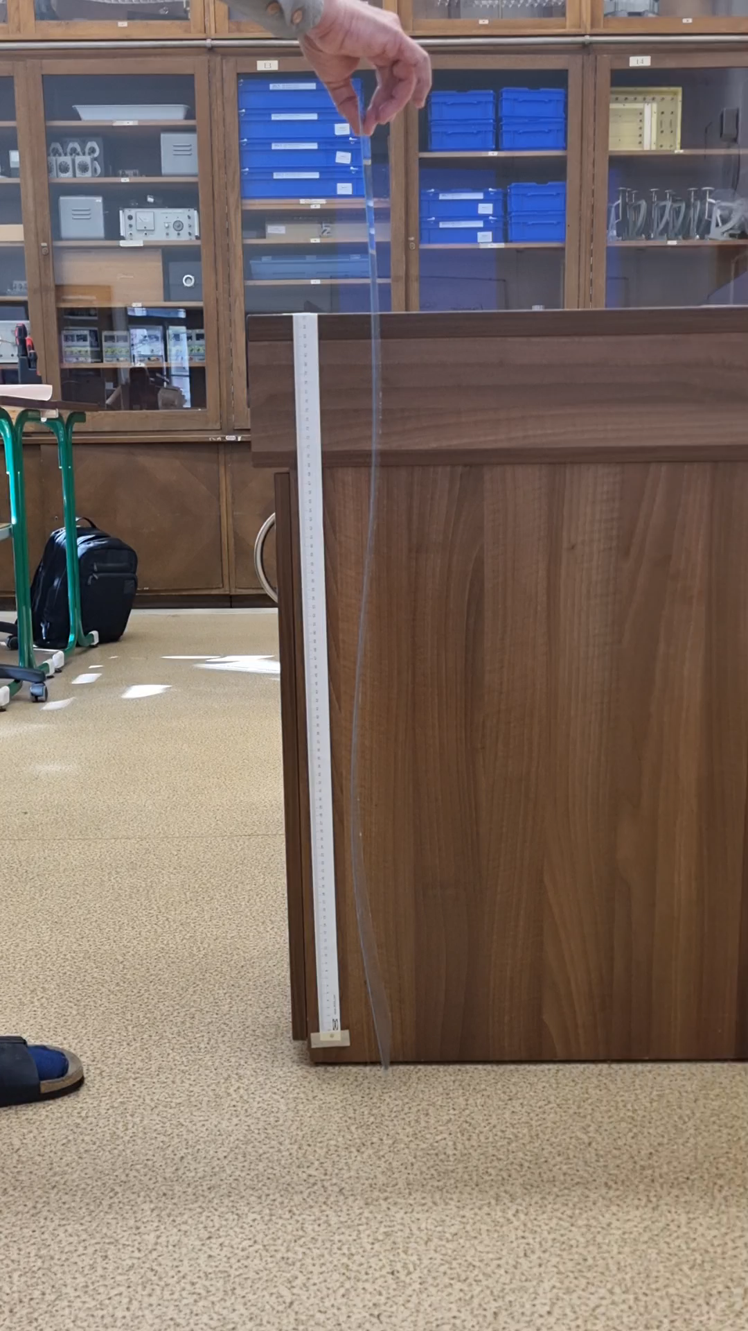
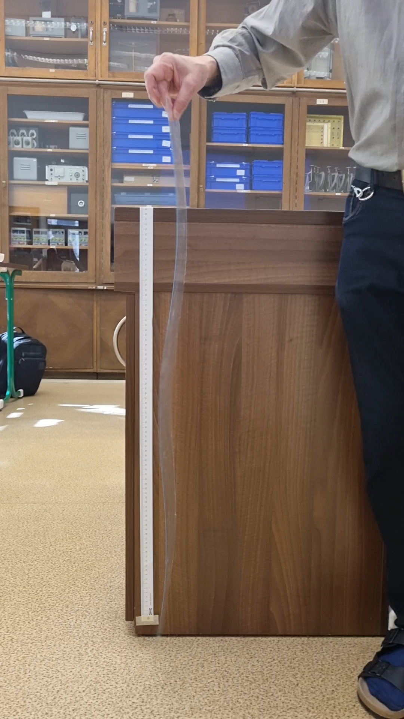
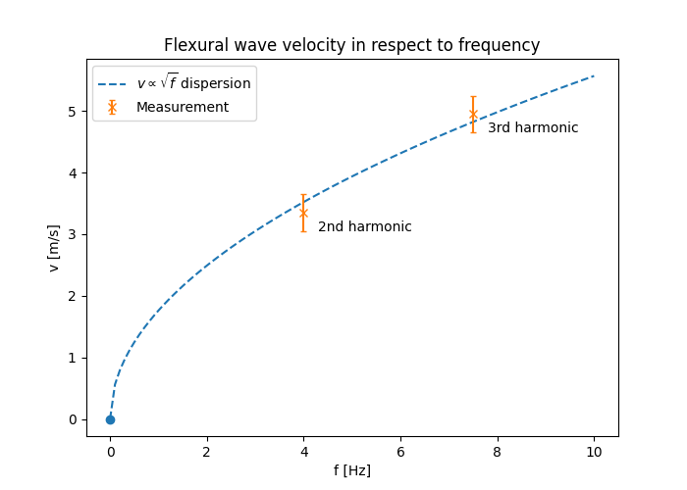
Flexural wave velocity confirmation
Measurement
2nd harmonic
3rd harmonic

Slide 11
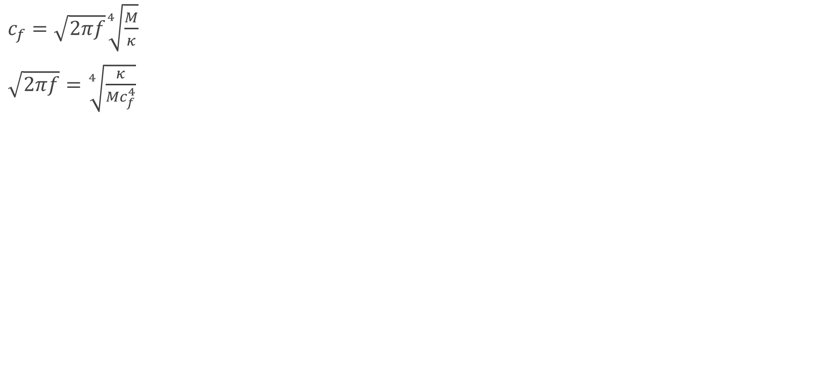
$c_{f}=\sqrt{2πf}\sqrt[4]{\frac{M}{κ}}$
$\sqrt{2πf}=\sqrt[4]{\frac{κ}{{Mc}_{f}^{4}}}$

Slide 12
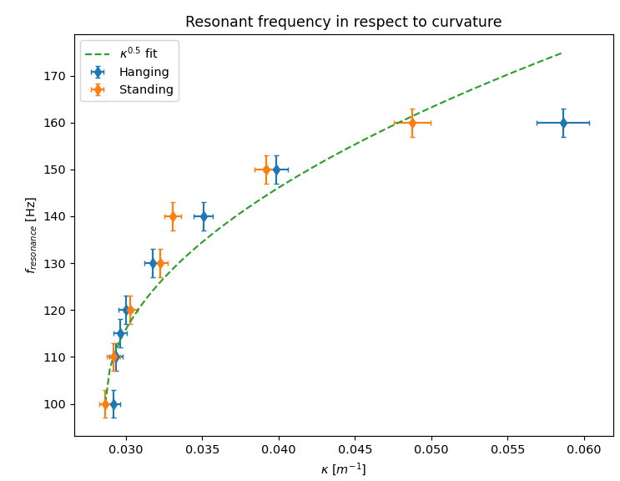
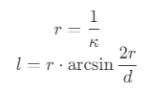
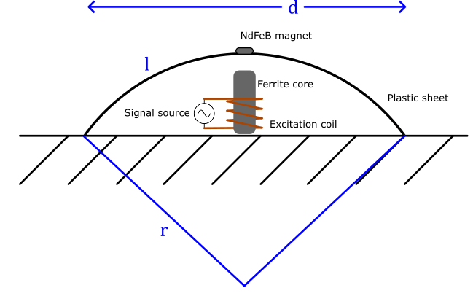
Resonant frequency while bending
The measured curvature was changed to match a defined excitation frequency in two configurations:
Hanging
Standing
Material: 70cm x 50cm x 1mm plastic

Slide 13
Summary
Summary
The cause of the howling sound is the fast snap throught the position of no curvature
We‘ve been able to explain the causes of pitch shifting which are:
Change of bending stiffness due to curvature
Dispersive behaviour of flexural waves
We‘ve been able to measure the change of the pitch using a spectrogram
Lastly, we measured the relationship between the resonant frequency and curvature
Next plans:
Mathematically describing the relationship of curvature and resonant frequency

